Slide 1



Assignment - 4
by Aman Tewary & Nikhil Kamath
View in Power BI
Last data refresh:
7/2/2018 4:52:39 PM Atlantic Standard Time
Downloaded at:
7/2/2018 5:22:44 PM Atlantic Standard Time

Slide 2
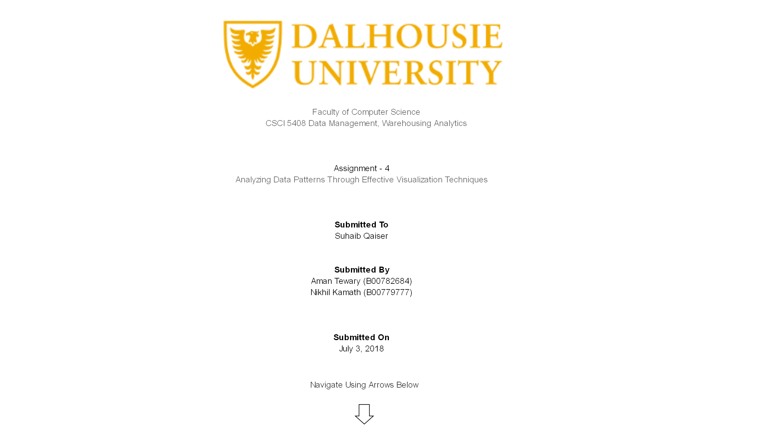

Slide 3
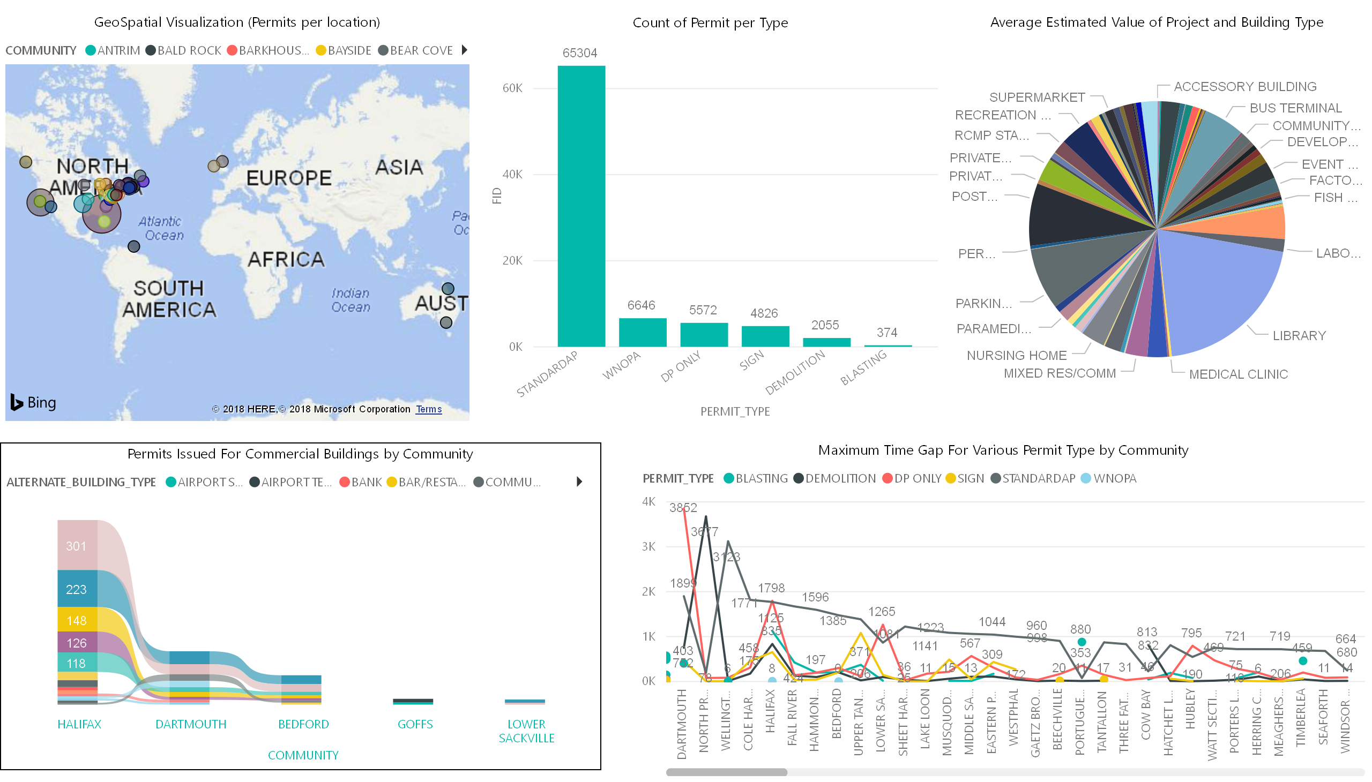

Slide 4
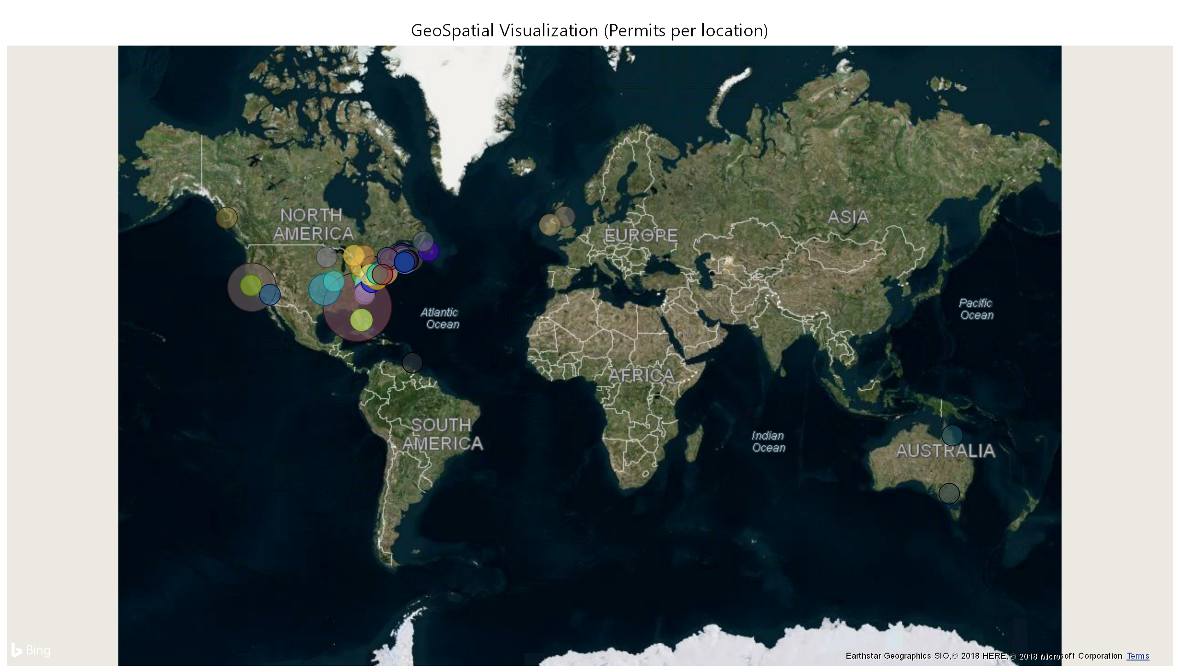

Slide 5
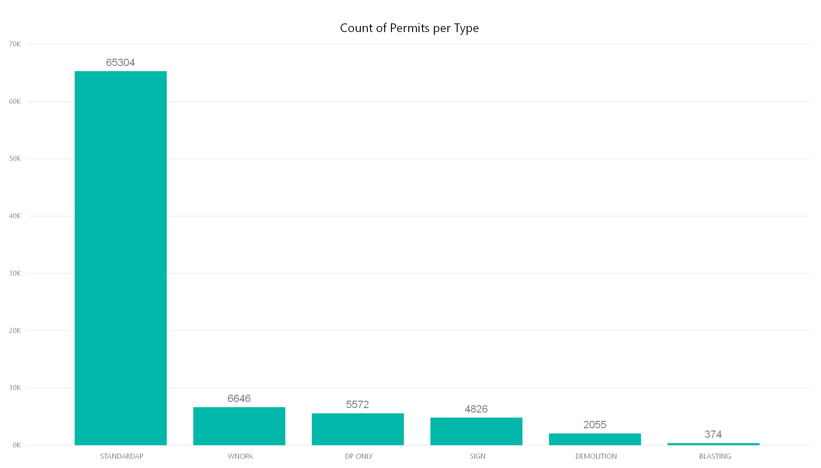

Slide 6
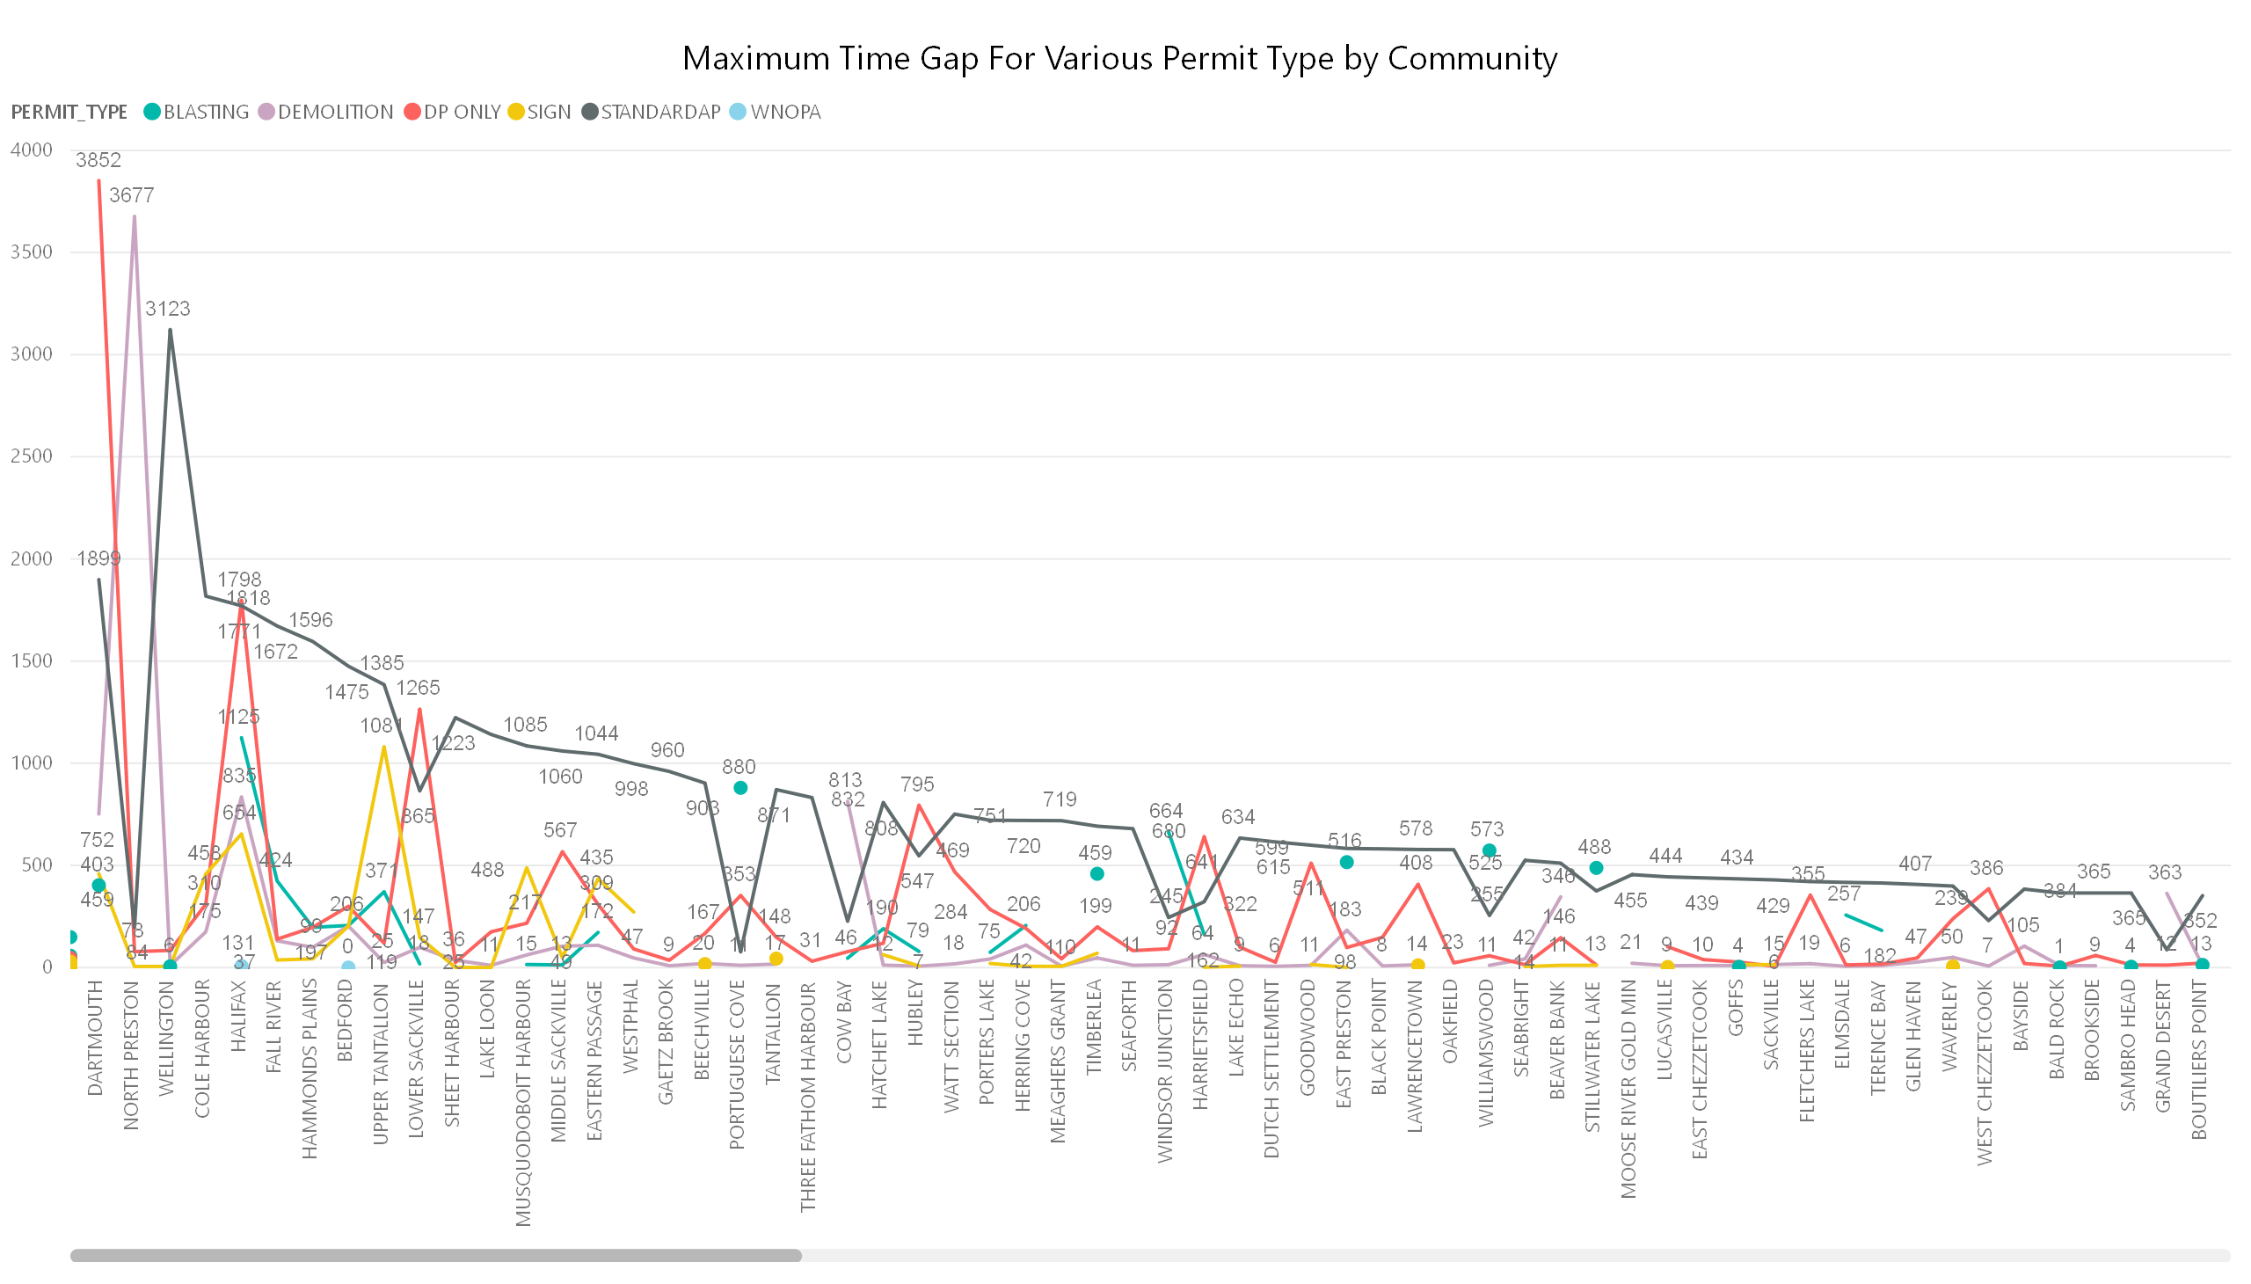

Slide 7
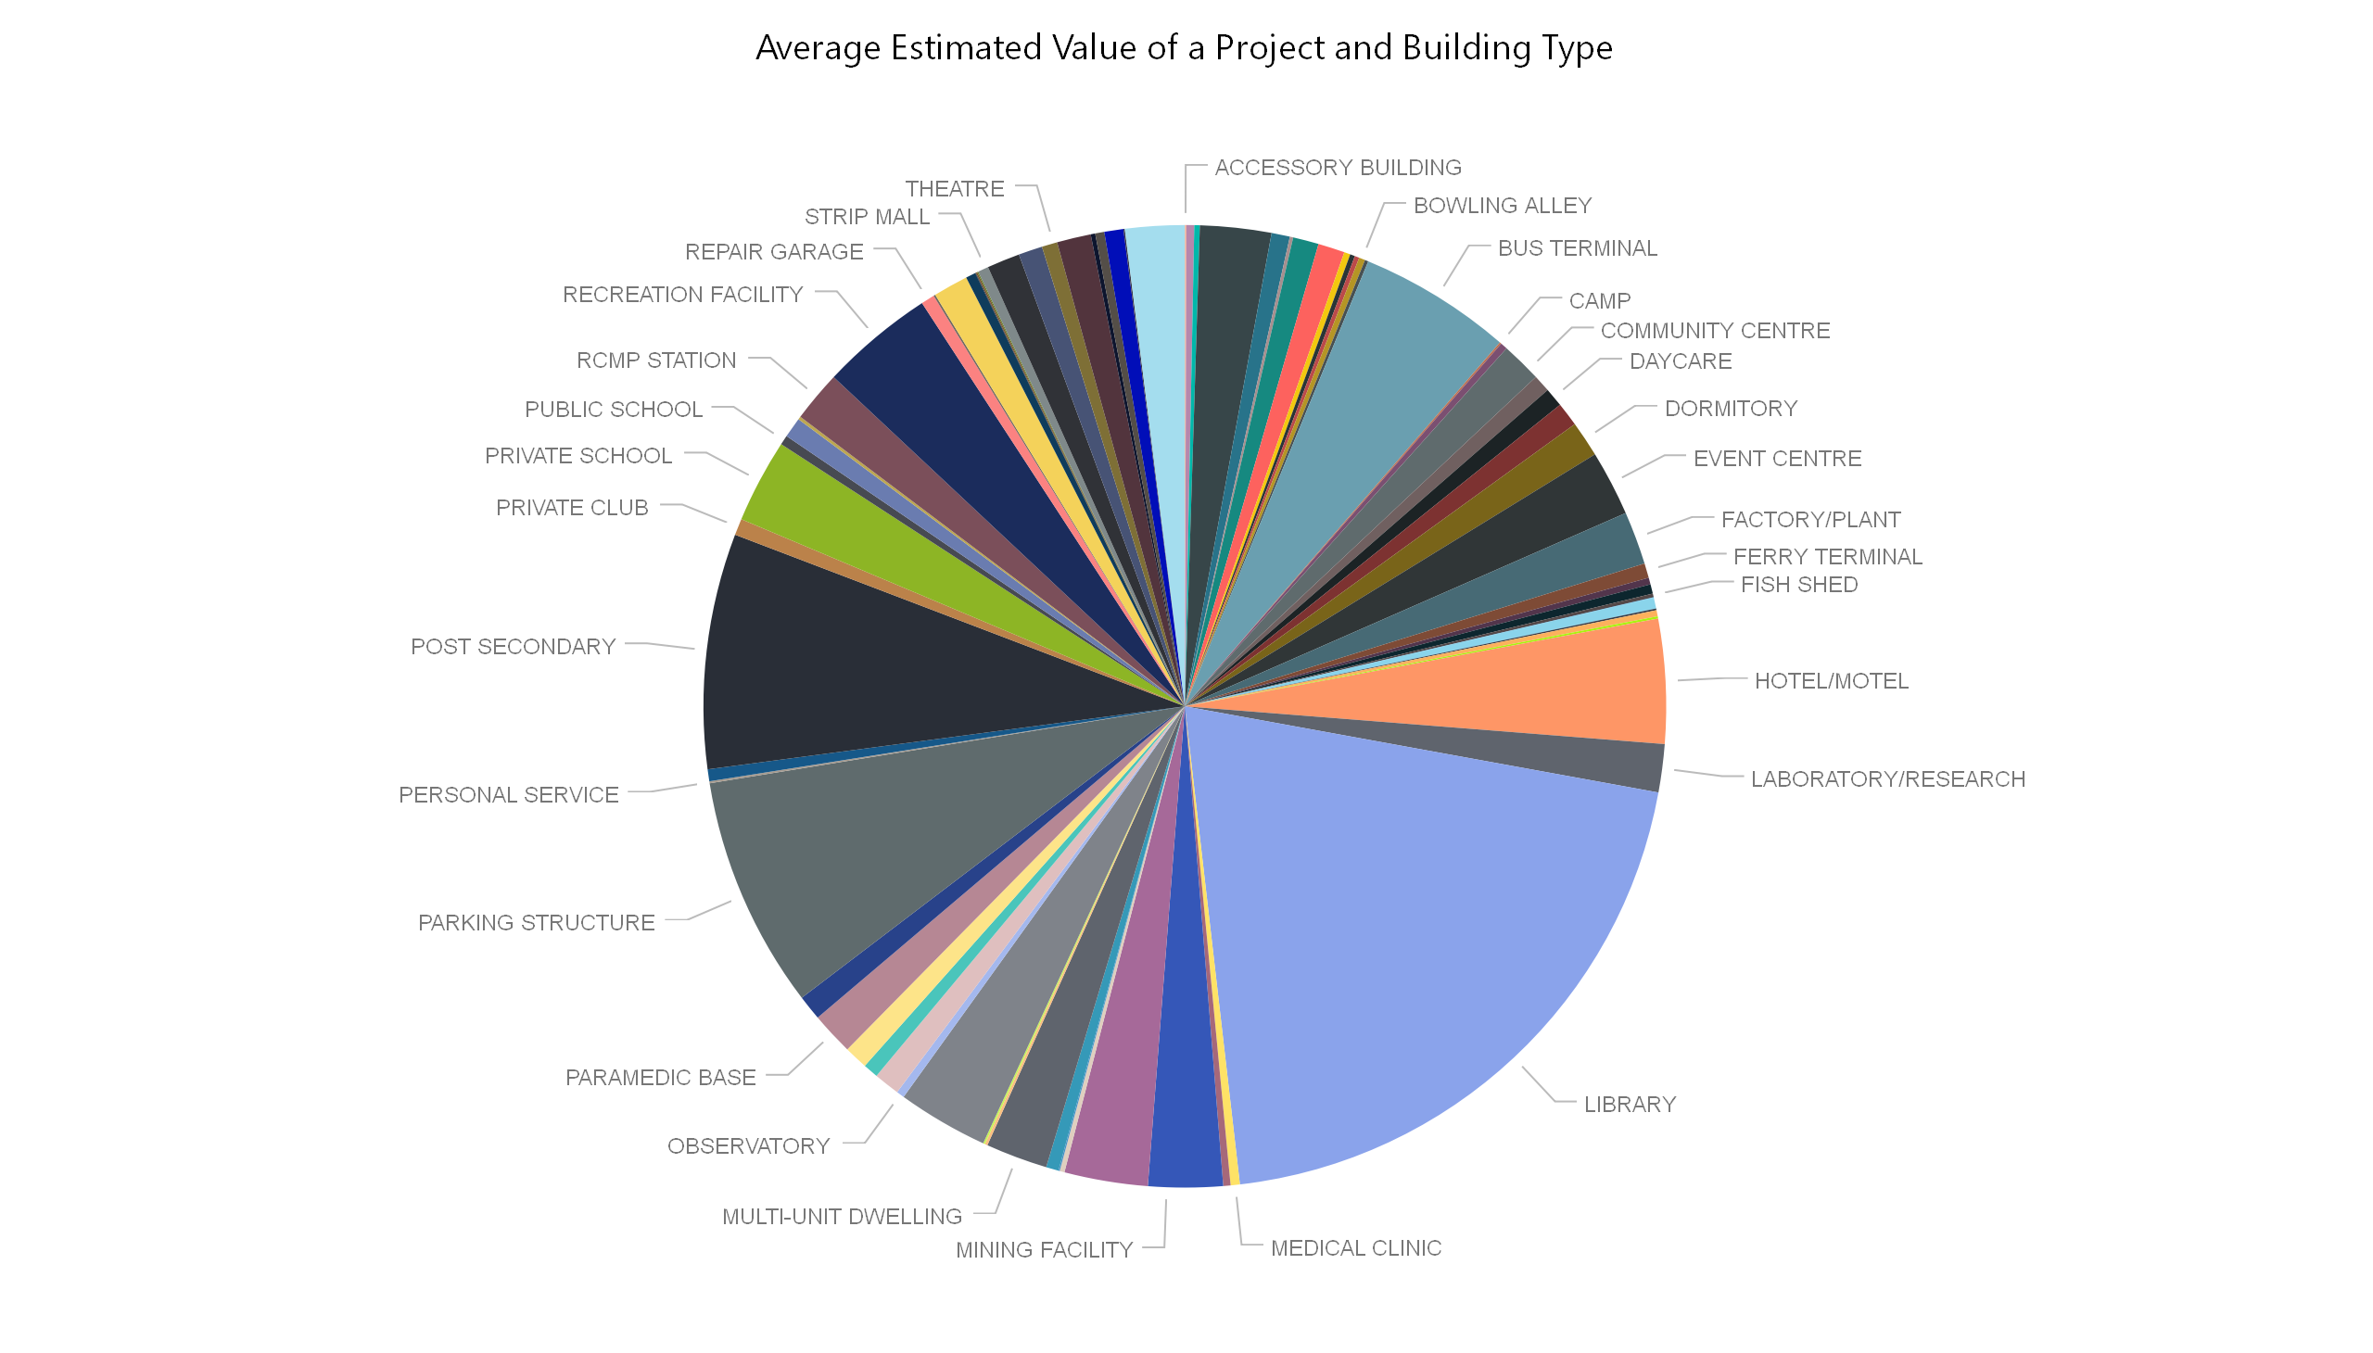

Slide 8
